Slide 1
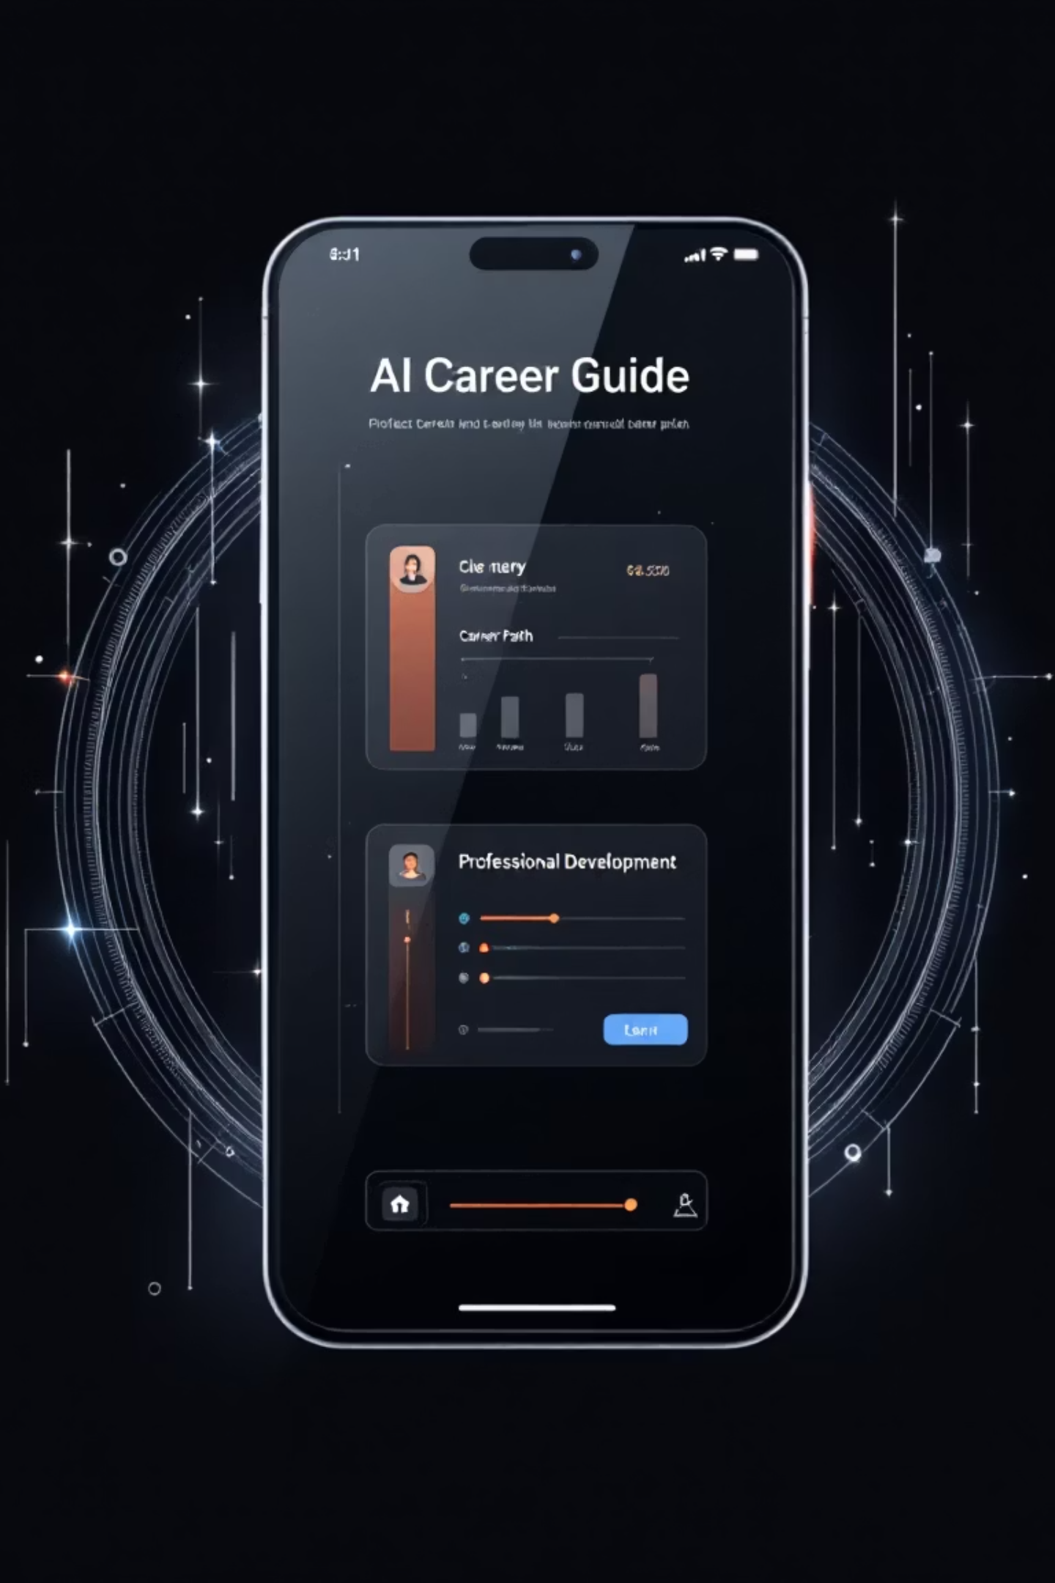
AI Enhanced Career Guide Application
A comprehensive, modern, and highly personalized mobile platform leveraging Generative AI for career planning, educational choices, skill development, and interview preparation.

Slide 2
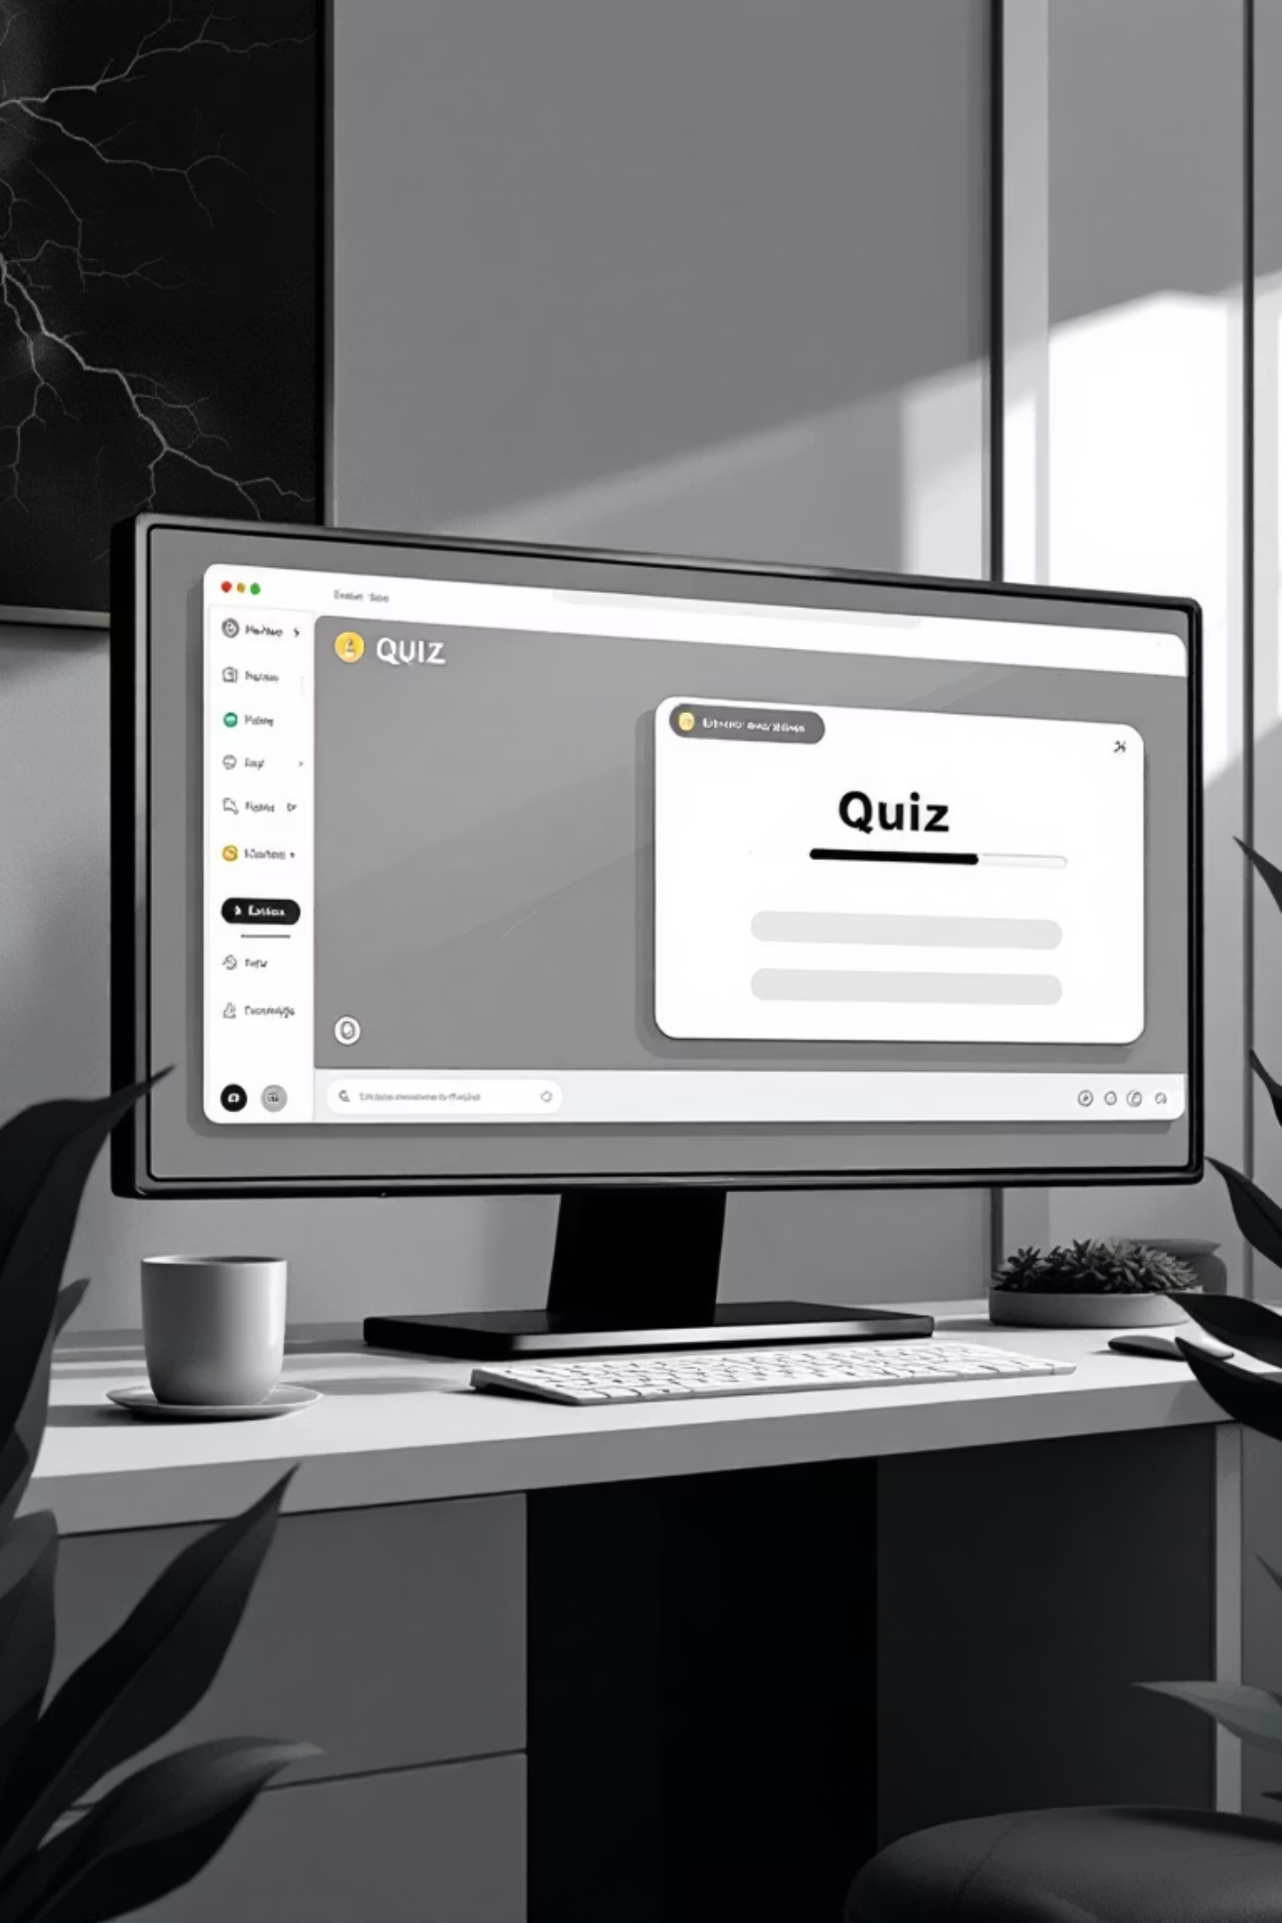

Core Features: AI-Powered Guidance
AI-Powered Chatbot
AI Quiz Generator
Real-time conversational guidance via Gemini API for career and study advice.
Dynamically generates quizzes on any topic for immediate knowledge assessment.
Progress Tracker
Add, track, and monitor professional and educational goals.

Slide 3
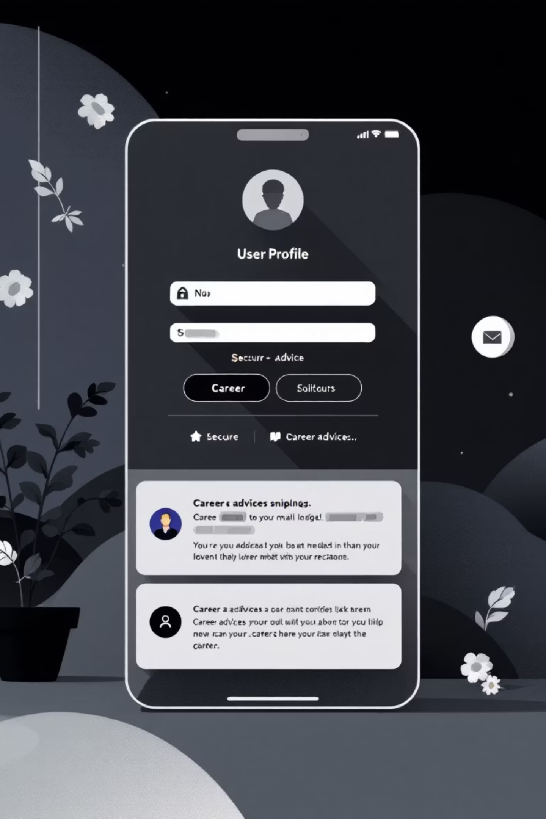
Key Functionalities
Career Tips & Insights
Secure User Authentication
Curated and personalized advice to complement chatbot guidance.
Dedicated login/signup with email and password, data secured in MongoDB.
Modular Interface
Clean dashboard, navigation buttons, profile section, and Dark Mode for enhanced UX.

Slide 4





Challenges Addressed
Generalized Advice
Lack of Practice
Replaced static advice with personalized, real-time guidance via Generative AI.
Provided on-demand quiz tool for immediate knowledge testing and skill validation.
Disorganized Planning
Technology Integration
Offered a Progress Tracker to formalize and monitor career goals.
Successfully integrated Gemini API and MongoDB into a cohesive Android app.

Slide 5

End Users
Students
Seeking guidance on educational paths and college majors.
Job Seekers
Needing interview preparation, resume advice, and job market insights.
Working Professionals
Looking for upskilling tips, career change advice, and professional goal tracking.

Slide 6
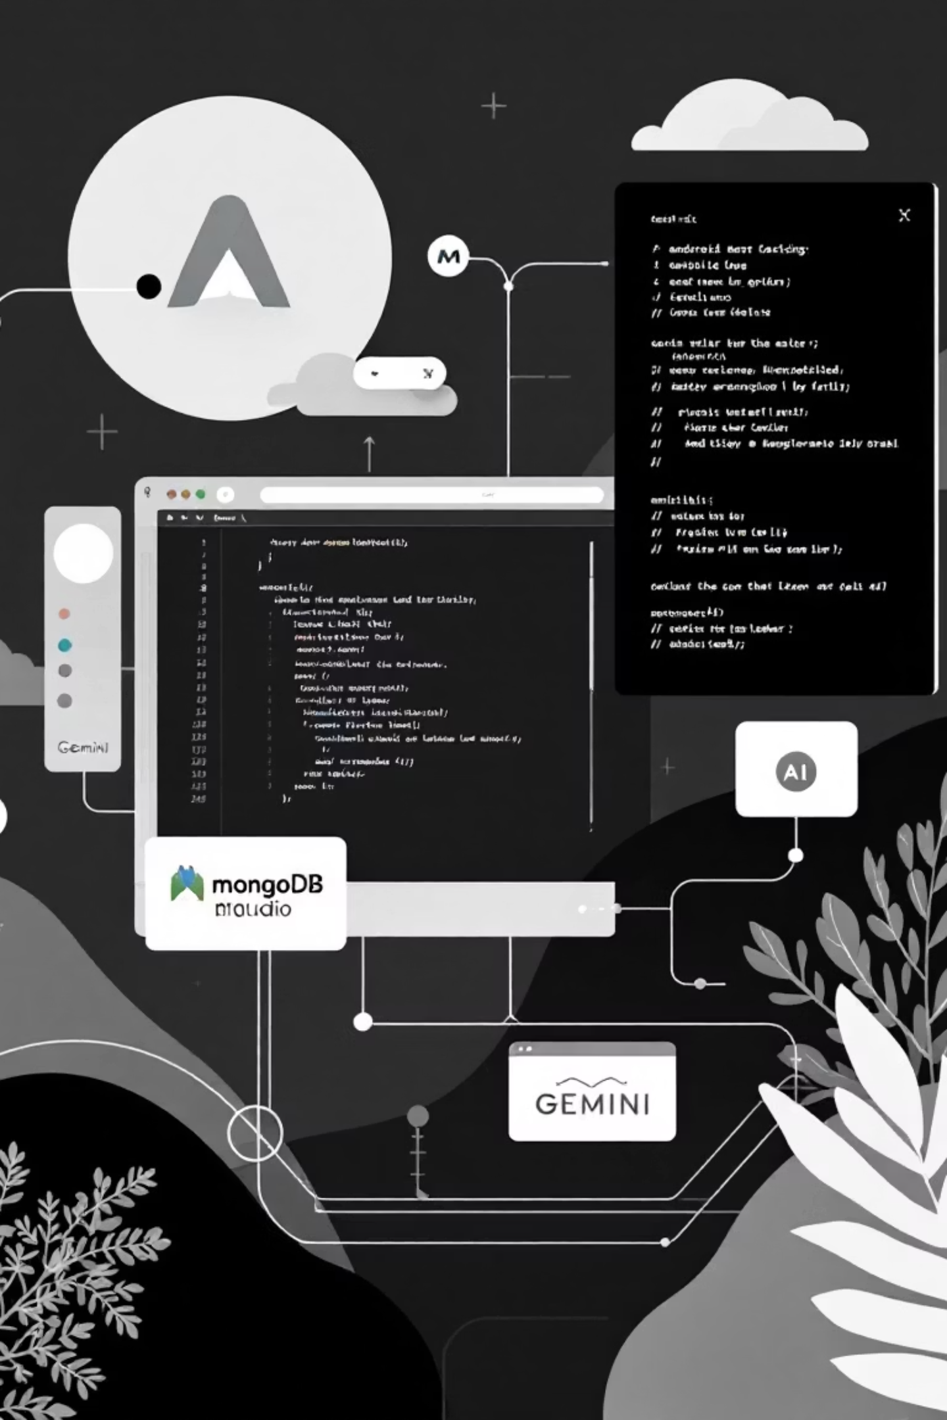
Technology Stack
Front End: Android Studio
Back End: MongoDB + Gemini API
Kotlin: Primary language for modern, concise, and safe Android development.
MongoDB: NoSQL database for user data, chat history, and progress data.
XML: Used for defining UI layout and structure.
Gemini API: Core AI engine for generative chat and intelligence.
Material Design: Ensures a clean, consistent, and intuitive user experience.
Custom Auth: Secure login/signup system.

Slide 7



Future Scope: Advanced Personalization
Skill Gap Analysis
Identify skill gaps and suggest relevant external courses or resources.
Adaptive Guidance
Refine chatbot responses using stored user data for more personalized advice.
Predictive Career Paths
Suggest suitable future career transitions based on market trends and user profile.

Slide 8
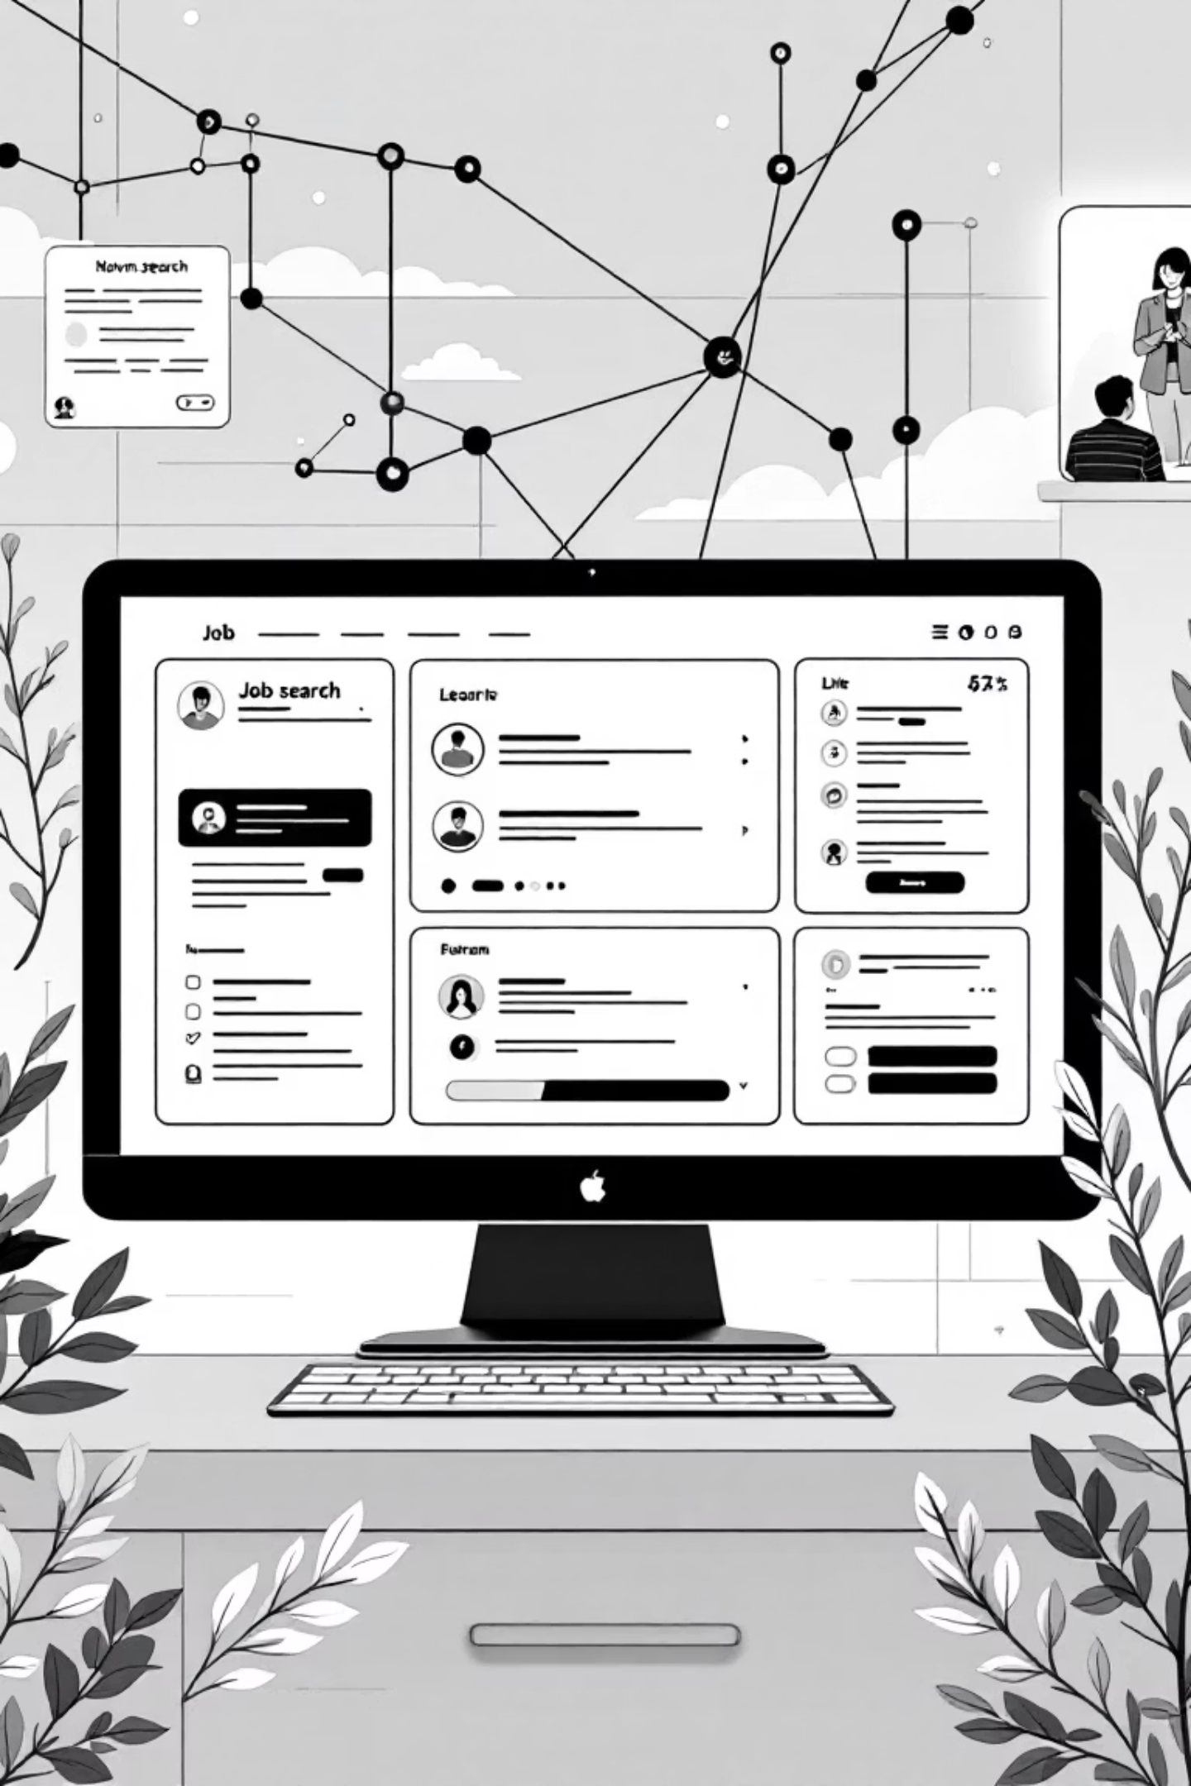
Future Scope: Integration & Engagement
External API Integration
Community & Gamification
Job Listing: Integrate with popular job boards like Indeed and LinkedIn.
Peer Mentorship: Connect users for study groups and networking.
Resume Builder: In-app tool to optimize resumes and cover letters.
Expert Q&A: Secure forums for questions to industry experts.
Resource Linking: Connect to reputable courses and certification bodies.
Gamification: Interactive dashboards and achievement badges.

Slide 9

Conclusion: A Revolution in Career Development
CareerBot is a successful endeavor in creating an intelligent, scalable, and user-focused tool for career development on Android.
Seamless AI Integration
Robust Data Management
Holistic User Experience
Gemini API for chatbot and quiz generation.
MongoDB for secure user and historical data.
AI guidance with practical tools like Progress Tracker.

